Slide 1
IEEE UCF SKILL SERIES
PCB Design
Part 1: Intro to KiCAD and Schematic Capture

Slide 2



Slide 3
What You Will Learn Schedule
Overview of PCB design
KiCAD schematic and layout editor tools
Best practices for component selection, placement, and routing
Design Rules Check (DRC)
Workshop 1 (Today):
What is a PCB?
Setting up KiCAD
Schematic capture
Choosing components
Workshop 2 (10/6):
PCB layout editor
Routing traces
Design Rule Check (DRC)

Slide 4
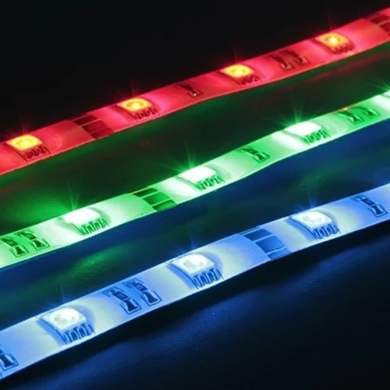
What You’ll Be Making
RGB LED strip lighting controller
3 analog dials for adjusting color/brightness
IR sensor for remote control of LEDs
Powered by a micro USB cable from a 5V wall outlet
ON/OFF switch

Slide 5
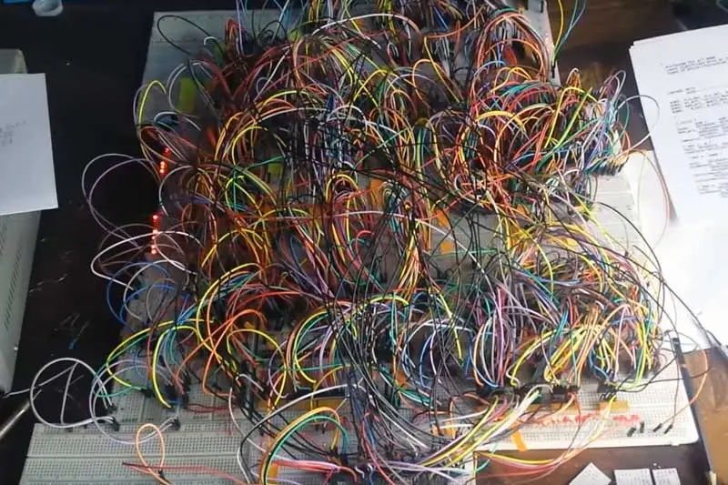
Motivation: Why make a PCB?

Slide 6
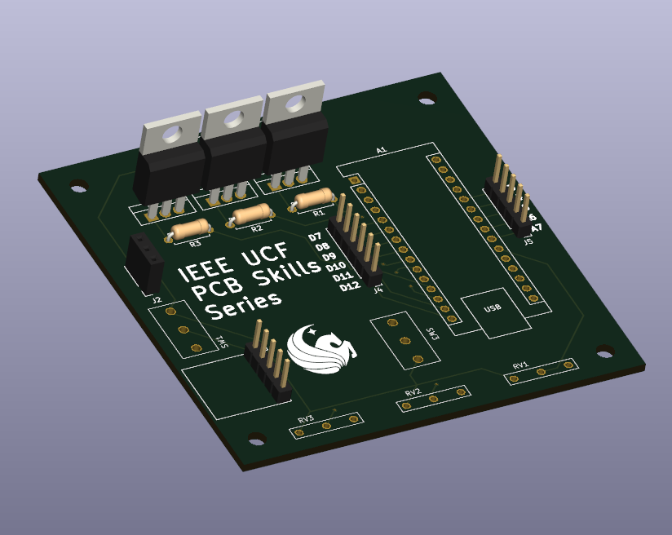
What is a PCB?
“Printed Circuit Board”
Useful when circuit has too many connections to be made by hand
Physical wire connections are replaced by conductive channels, or “traces”
Components can be mounted through holes or pads on the PCB

Slide 7
Getting Started
KiCAD, pronounced Key-CAD is an EDA, or Electronic Design Automation tool.
EDA Tools are used to create electrical schematics and printed circuit boards, which can then be sent to fabs such as JLCPCB or OSHPark to be manufactured.
We will be using KiCAD for this skills series because it is free and open-source, user-friendly, and comprehensive in its schematic capture and layout features.

Slide 8

Downloading and Installing KiCAD
Download KiCAD: https://www.kicad.org/download/
Github for component library:
https://github.com/cbrynds/IEEE-UCF-KiCAD-Skills-Series
Optional Getting Started:
https://docs.kicad.org/7.0/en/getting_started_in_kicad/getting_started_in_kicad.html

Slide 9
Useful Schematic Editor Keyboard Shortcuts
Schematic Editor:
A: place a symbol
W: draw a net
L: add a label
Q: add a no connection flag
T: add text
V: edit value
U: edit reference designator
E: Properties
R: rotate symbol
G: drag
M: move
More shortcuts: https://www.siue.edu/~gengel/ece326WebStuff/KiCAD-hotkeys.pdf

Slide 10
Common Terminology
Schematic Editor - create symbolic representation of circuit
Layout Editor - create physical PCB layout
Net - signal wire connecting two circuit nodes
Symbol - representation of circuit element
Reference Designator - unique identifier for circuit component
Value - resistance, capacitance, etc
Footprint - bounding box for component to be placed on PCB
Label - links two nodes without drawing a physical net
Electrical rules check (ERC) - ensures that all circuit nodes are properly linked by nets

Slide 11
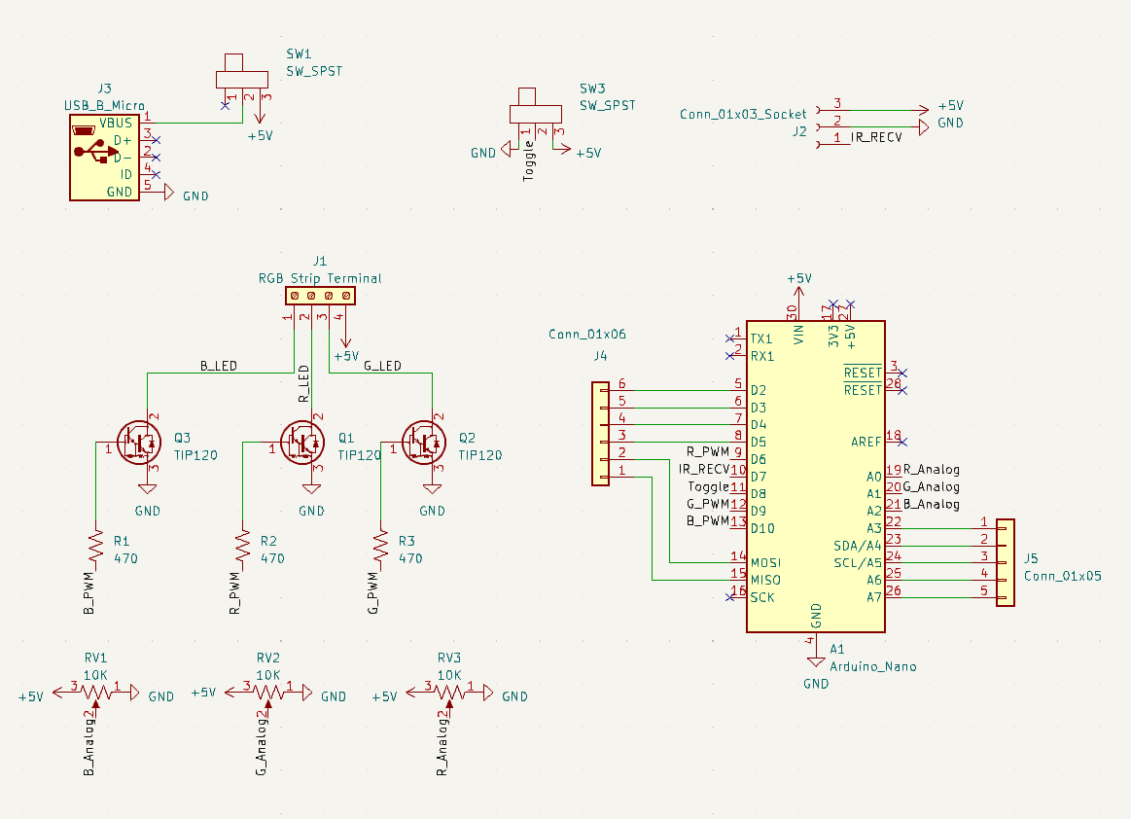
What is a schematic?
“Schematic” - circuit blueprint
A graphical representation of the circuit
All component- to-component connections are shown
The position of symbols does not matter

Slide 12
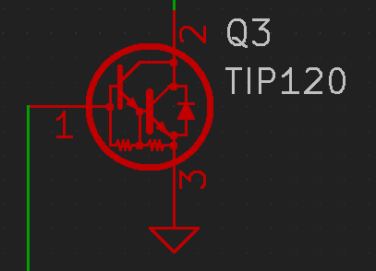
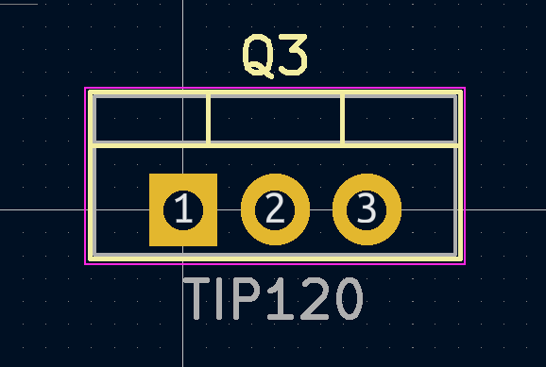
Symbols vs Footprints
Symbol
A symbol is the graphical representation of a component, while a footprint is physical component on the PCB
A footprint has defined dimensions, pad sizes, and other manufacturing info
A symbol has pin connections and generic info about the component
Footprint

Slide 13
Getting started: Creating a Project

Slide 14
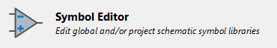
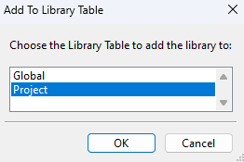
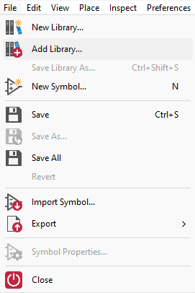
Getting Started: Importing Symbol Library

Slide 15
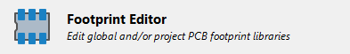
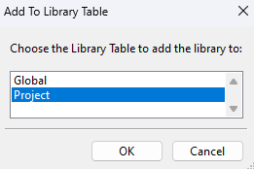
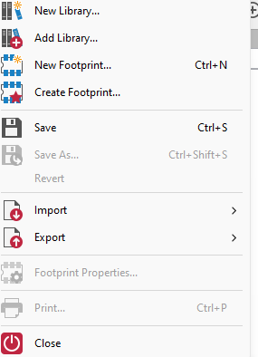
Getting Started: Importing Footprint Library

Slide 16
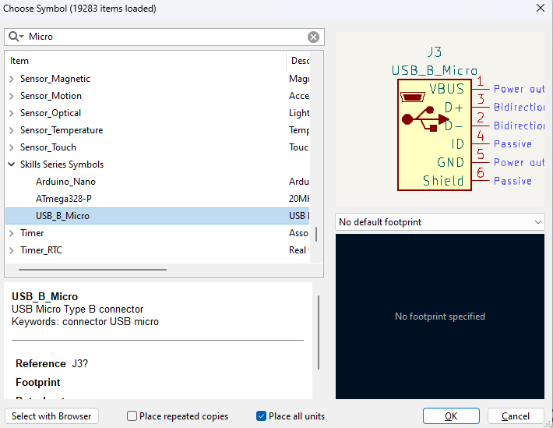
Getting started: Placing Symbols
Access symbol menu by ‘A’ hotkey or place toolbar -> Add Symbol
Can search by symbol name or attributes

Slide 17
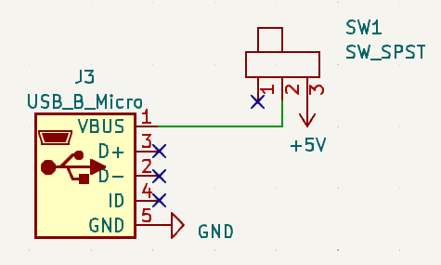
Creating Power Circuit

Slide 18
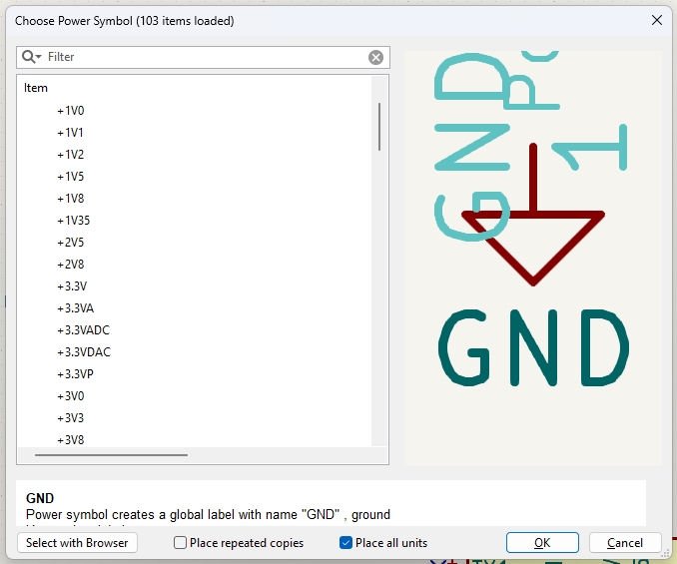
Power and Ground Symbols
Access power menu by ‘P’ hotkey or “place” toolbar -> Add Power
Various symbols for power and ground
+-X V, VCC, VDD
Earth Ground, Chassis Ground, Digital Ground, etc.

Slide 19
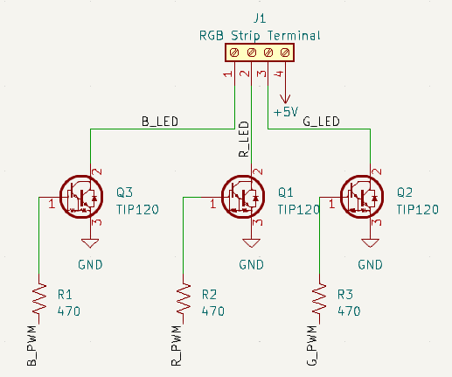
Creating Lighting Controller Circuit

Slide 20
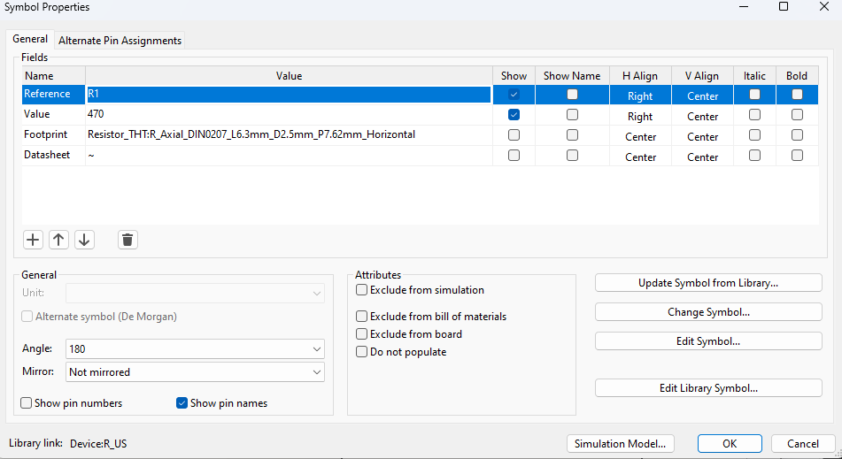
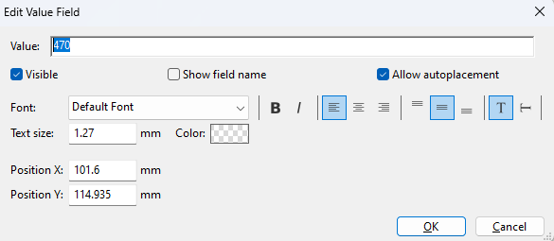
Editing Component Values/Ref. Designators
A Few methods
Hover over symbol, press V (or U for ref designator)
Double click on component, edit value/RD field
Right click on component -> edit main fields -> edit value/RD

Slide 21
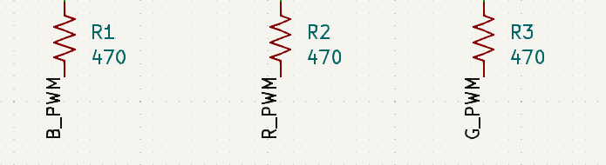
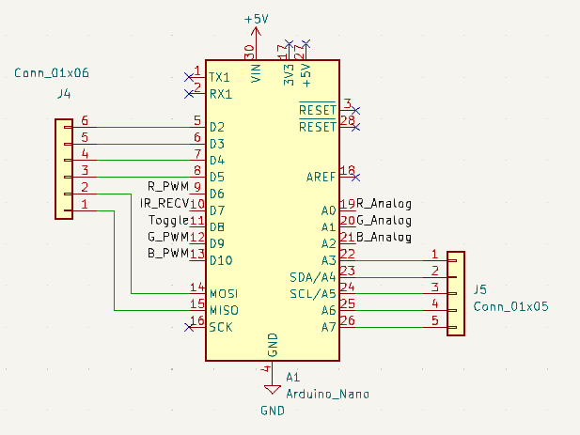
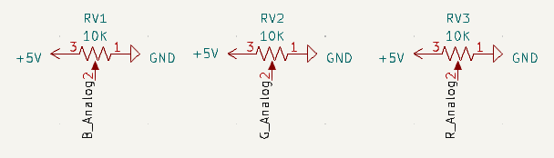
Making Connections: Pin Labels

Slide 22
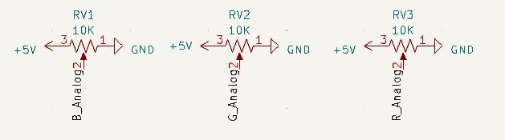
Creating Potentiometer Circuit

Slide 23
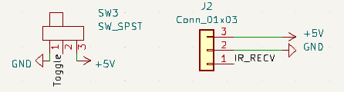
Toggle Switch and IR Receiver Circuits

Slide 24
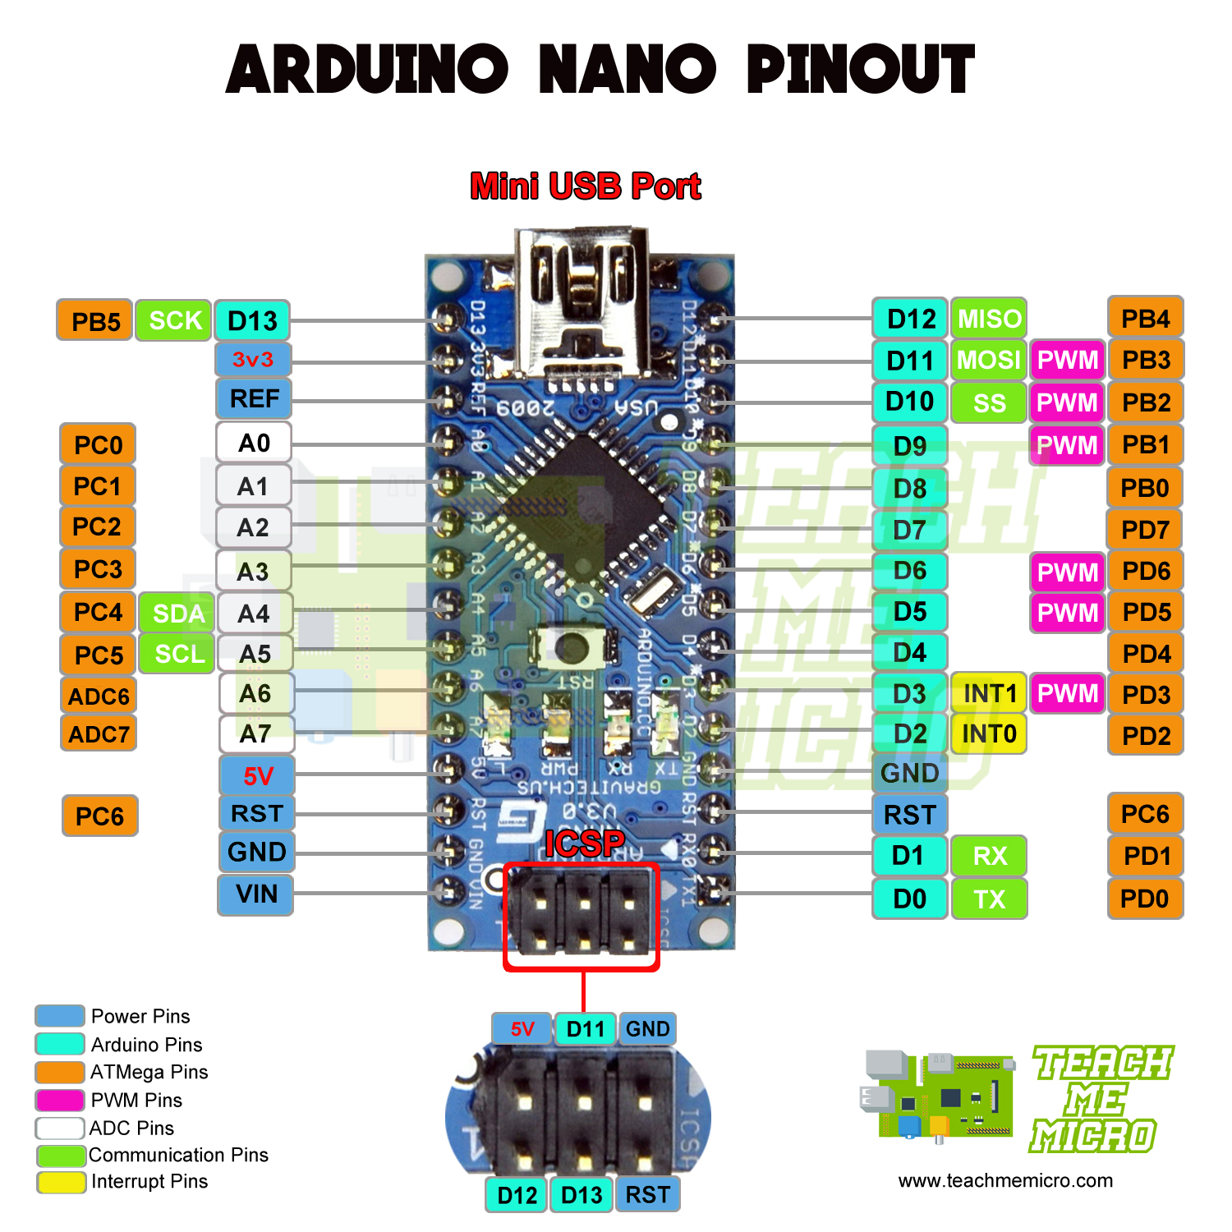
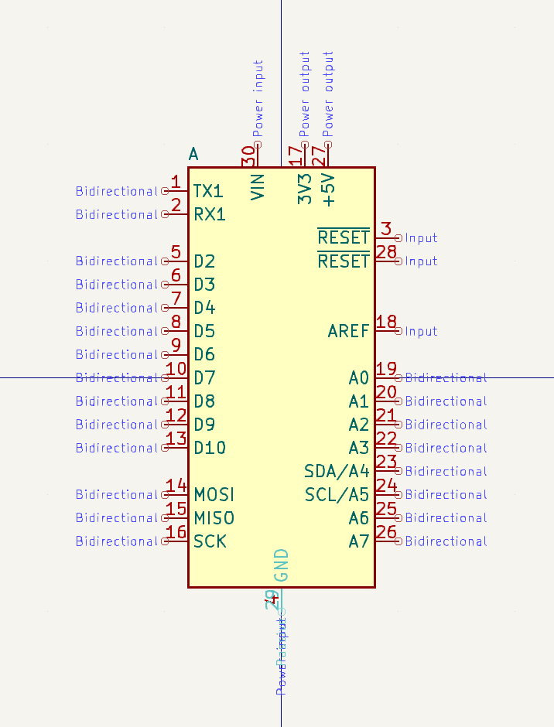
Arduino Nano: Circuit vs Symbol

Slide 25
Creating Arduino Nano Circuit

Slide 26
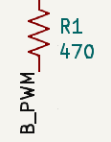
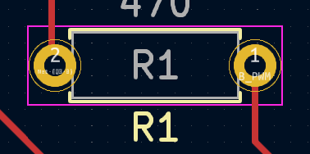
Reference Designation
Reference designator: unique tag to identify component type and number
R1, R2, … for resistor
C1, C2, … for capacitor
U1, U2, … for ICs
Etc
Links symbol to footprint in layout editor
Used to identify component locations when assembling PCBs
Automatic designator assigns RDs to schematic symbols

Slide 27
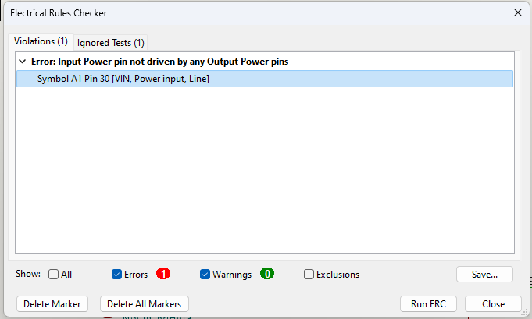
Electrical Rules Check
Inspect -> ERC -> Run ERC
Ensures that schematic doesn’t violate any electrical rules
I.e. there are no nodes missing connections
May receive error: power input pin not driven by any output power pins
Solution: place a “Power Flag” on the +5V net

Slide 28
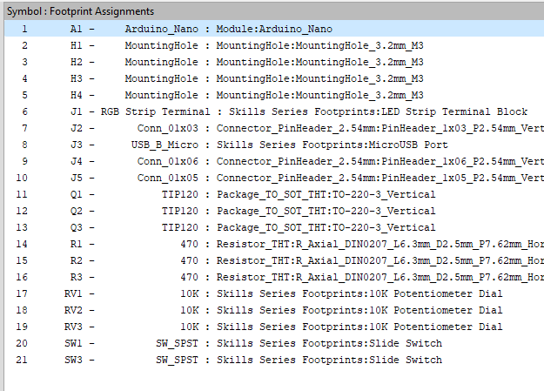
Footprint Assignment Tool
Toolbar -> Run Footprint Assignment Tool
Currently, symbols aren’t mapped to any physical hardware
A “Footprint” consists of the pads/holes a component is soldered to and the silkscreen boundaries on the PCB
The footprint assignment tool maps pins from symbol to a physical footprint
Some symbols may already have footprints linked to them

Slide 29
IEEE UCF SKILL SERIES
PCB Design
Part 2: PCB Layout and Routing
10/6 from 5:00-7:00 in ENG1 224

Slide 30
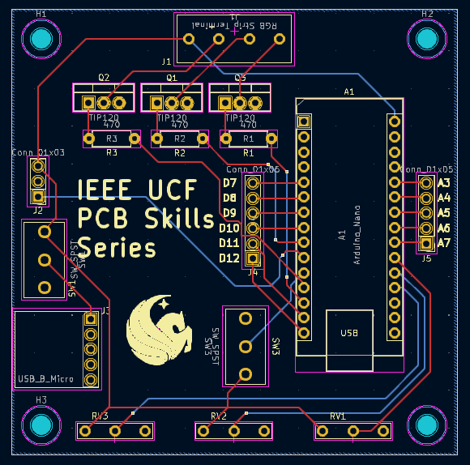
What is a Board Layout?

Slide 31
Useful Footprint Editor Keyboard Shortcuts
Footprint editor:
A: place a footprint
X: draw a trace
S: redefine grid origin
V: toggle between F.Cu and B.Cu
Ctrl + shift + V: place a via
Ctrl + shift + L: draw a line
B: Fill all zones
E: properties
R: rotate symbol
M: move
More shortcuts: https://www.siue.edu/~gengel/ece326WebStuff/KiCAD-hotkeys.pdf

Slide 32
Common Terminology
Layout Editor - used to specify board boundaries and placement of footprints on a PCB
Trace - copper track connecting two pads/holes
Via - “Vertical interconnect access”, hole through the PCB that connects two layers
Plane - common connection surface on a layer
Footprint - contains silkscreen boundary of a component and location of pads/holes for connections
Through-hole vs Surface-mount
Silkscreen/Solder mask - text and graphics printed on the PCB for user readability
Design Rule Check (DRC) - ensures that PCB doesn’t violate any electrical or mechanical rules set by PCB manufacturers

Slide 33
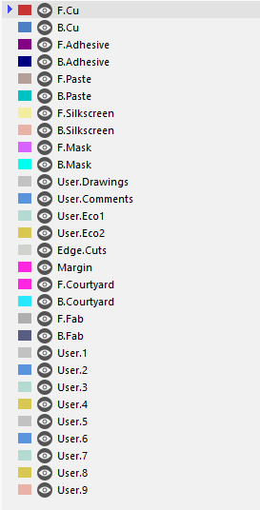
Board Layers
Front Copper/Bottom Copper: routing layers that interconnect components
Components, traces, vias, planes, etc. will be on F.Cu and B.Cu
Solder mask: thin protection layer applied over copper layers; gives PCB the green color
Silkscreen: surface finish with text, footprint borders, and other graphics
Reference designators, values, and other text will be on silkscreen
Edge cuts: defines board outline and other manufacturing information

Slide 34
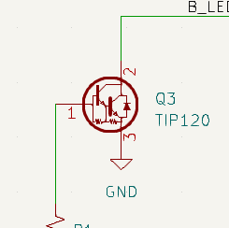
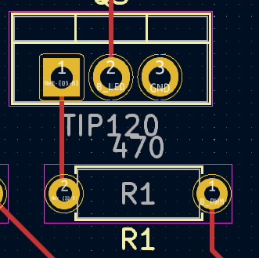
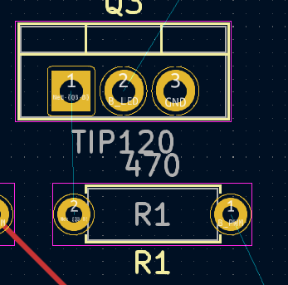
Nets vs Airwires vs Traces
Net: connection between two pins on a schematic
Airwire: Net translated to the PCB layout to show connection between pads
Trace: physical copper connection between pads
Net
Trace
Airwire

Slide 35
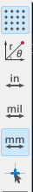
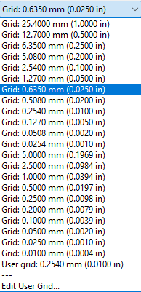
Grid Units
Pin spacing specified in non-metric units: 2.54mm, 5.08mm, etc
Board outlines and component placement often specified in metric units
1 mil = 1/1000 of an inch
Ex: 2.54mm = 100 mil
Change grid units with drop down or “N” hotkey

Slide 36
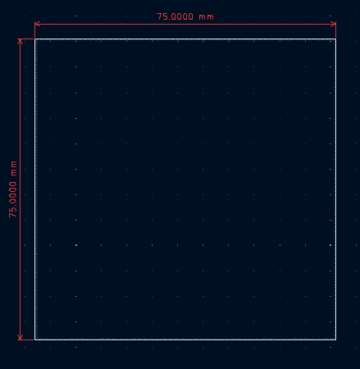
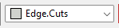
Getting Started: Define Board Dimensions
Dimensions used: 75 x 75 mm
Draw a rectangle on “Edge cuts” layer
Tip: change grid size (in bottom righthand corner) to 1mm

Slide 37
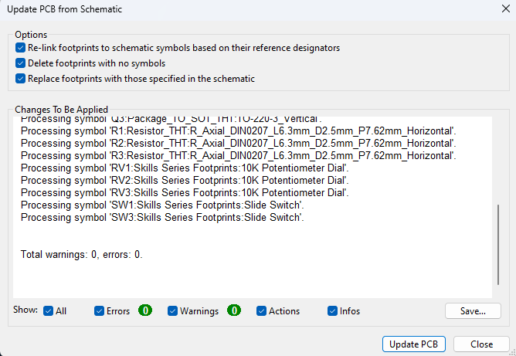

Getting Started: Update PCB from Schematic
Used to import footprint assignments from schematic
Must be re-run any time changes are made to the schematic

Slide 38
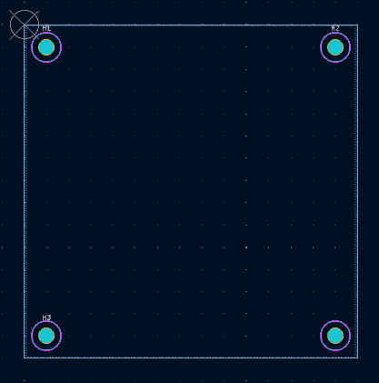
Placing Mounting Holes
Place M3 mounting holes in each of the four corners of the board
Inset the center of each hole 5mm from the corner of the board outline
Easiest way: offset each hole from the corner
Set grid origin to the corner of the board (“S” key)
Set grid units to 5mm

Slide 39
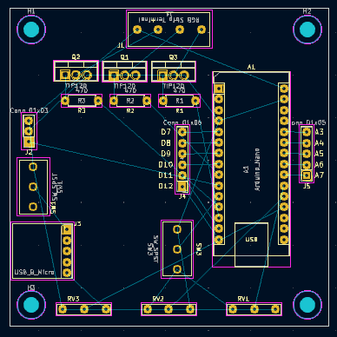
Component Placement
Design principles:
Place I/O components in convenient access locations
Place active logic (MCUs) and components with high connectivity in accessible areas
Isolate high-power or high-speed components and signals (not relevant to this PCB design)
Minimize the amount of airwire crossing/distance

Slide 40
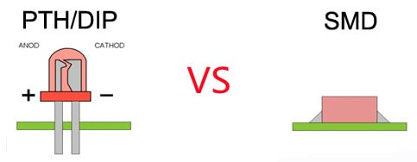
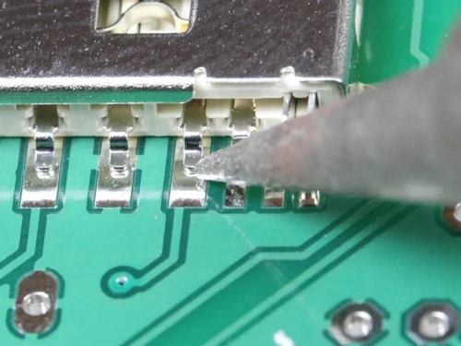
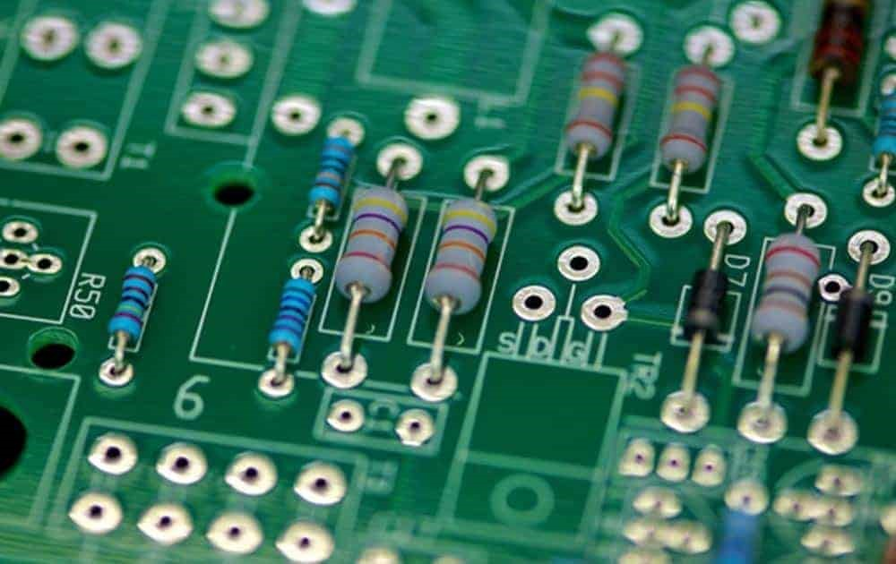
Footprint type: Through-Hole vs Surface-Mount
Surface mount
Through-hole

Slide 41
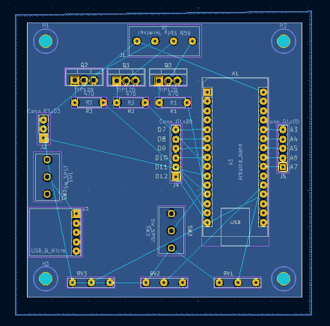
Ground Planes
Continuous area of copper on a PCB layer
Used to provide a return path (common ground) to the supply of a circuit
Also helps to reduce noise and dissipate heat in high-power, high-speed circuits
Greatly simplifies trace routing in a circuit
Usually created on the bottom layer of a two-layer PCB

Slide 42
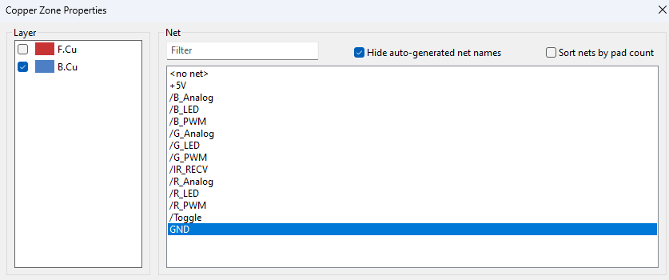
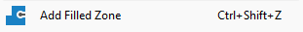
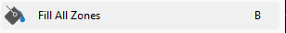
Creating a Ground Plane
Click “Add Filled Zone”
Select B.Cu and GND net
Draw an outline around board, extending beyond edge cuts
Right click and press “close outline”
Click “Fill All Zones” or press “B” to fill in ground plane

Slide 43
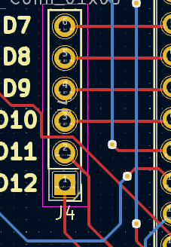
Trace Routing
Most involved part of PCB design
Trace: copper track that connects the pads of two components
Two traces on the same layer cannot cross each other - short circuit!
Goal: minimize the length of connections between components
Shorter trace = smaller signal propagation delay
Other considerations: trace width and spacing
Further reading

Slide 44
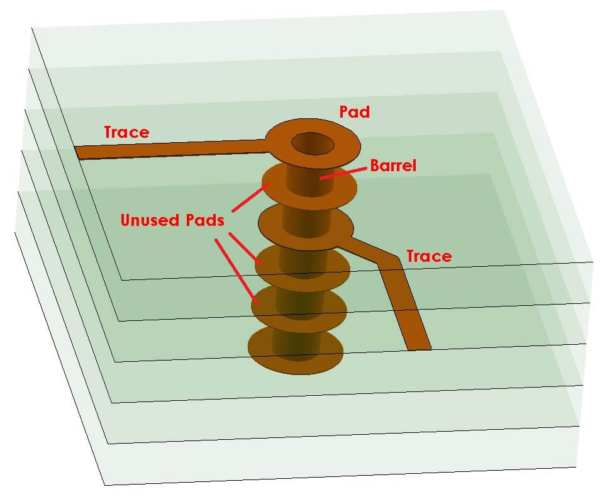
Vias
Vertical Interconnect Access (VIA)
Key idea: expand trace routing from 2->3 dimensions
Solution to intersecting traces
Copper tunnel between board layers
Different types of vias: through hole, buried, blind, micro
Further reading

Slide 45

Trace Routing: Live Demo
Routing considerations:
No trace overlap
No sharp turns: drag corners to smooth turns
Minimize path length
When not possible to route on the top layer, add a via and switch to the bottom layer

Slide 46


Adding Silkscreen Text
Silkscreen: text/graphics layer of the PCB that conveys assembly information such as
Component placement location
Component reference designators
Component values
Company logos
Electrical properties/operating conditions
Component pinouts
Main purpose is to enhance readability during assembly

Slide 47

Design Rules Check
Used to ensure that electrical and mechanical properties of the board do not violate any PCB manufacturers’ standards
Common errors/issues:
Unconnected trace: can usually be deleted
Silkscreen overlap: not a functional error, won’t prevent manufacturing
Courtyard overlap: if two components are overlapping on the PCB

Slide 48

Gerber File Generation
Gerber file: file format with all of drilling, etching, and silkscreen information from various layers
Gerber file is sent to manufacturers such as JLCPCB, OSHPARK, and PCBWay
Extra: can also auto-generate a bill of materials if footprints have linked part numbers

Slide 49


